Slide 1
Lecture 7 Supervised Machine Learning: Sentiment Analysis & Biomedical Text Classification
Sept 6th, 2023

Slide 2
Overview
Naïve Bayes leftovers (from slide 40)
Supervised Learning Intro
Definition
Regularization
Cross-fold Validation
Sentiment Analysis (abbreviated)
Document Classification in Biomedical Space (3 slides)

Slide 3
Supervised Machine Learning Intro
Supervised machine learning algorithms learn a function that maps some input to some output based on examples of input-output pairs
You need labelled data which can be hard to come across depending on your task
Examples
Naïve Bayes
Linear regression, logistic regression
Support Vector Machines
Decision Trees
Neural Networks
Many others…

Slide 4
Supervised Learning: Regularization
Smoothing is a form of statistical or mathematical regularization to better condition ill-fitting data to avoid over-fitting
Smoothing is a form of regularization
Note:
Regularization means something quite different in linguistics which is the replacement of irregular forms of speech/syntax/morphology with a more regular one
Ex) “Mice” -> “Mouses” would be (inappropriate) regularization

Slide 5
Assumptions of Regularization
Training data is limited
Dimensionality of problem space is high
Learning algorithms will over-fit data
These assumptions generally hold not just for Naïve Bayes and Language Model construction but for machine learning in general

Slide 6
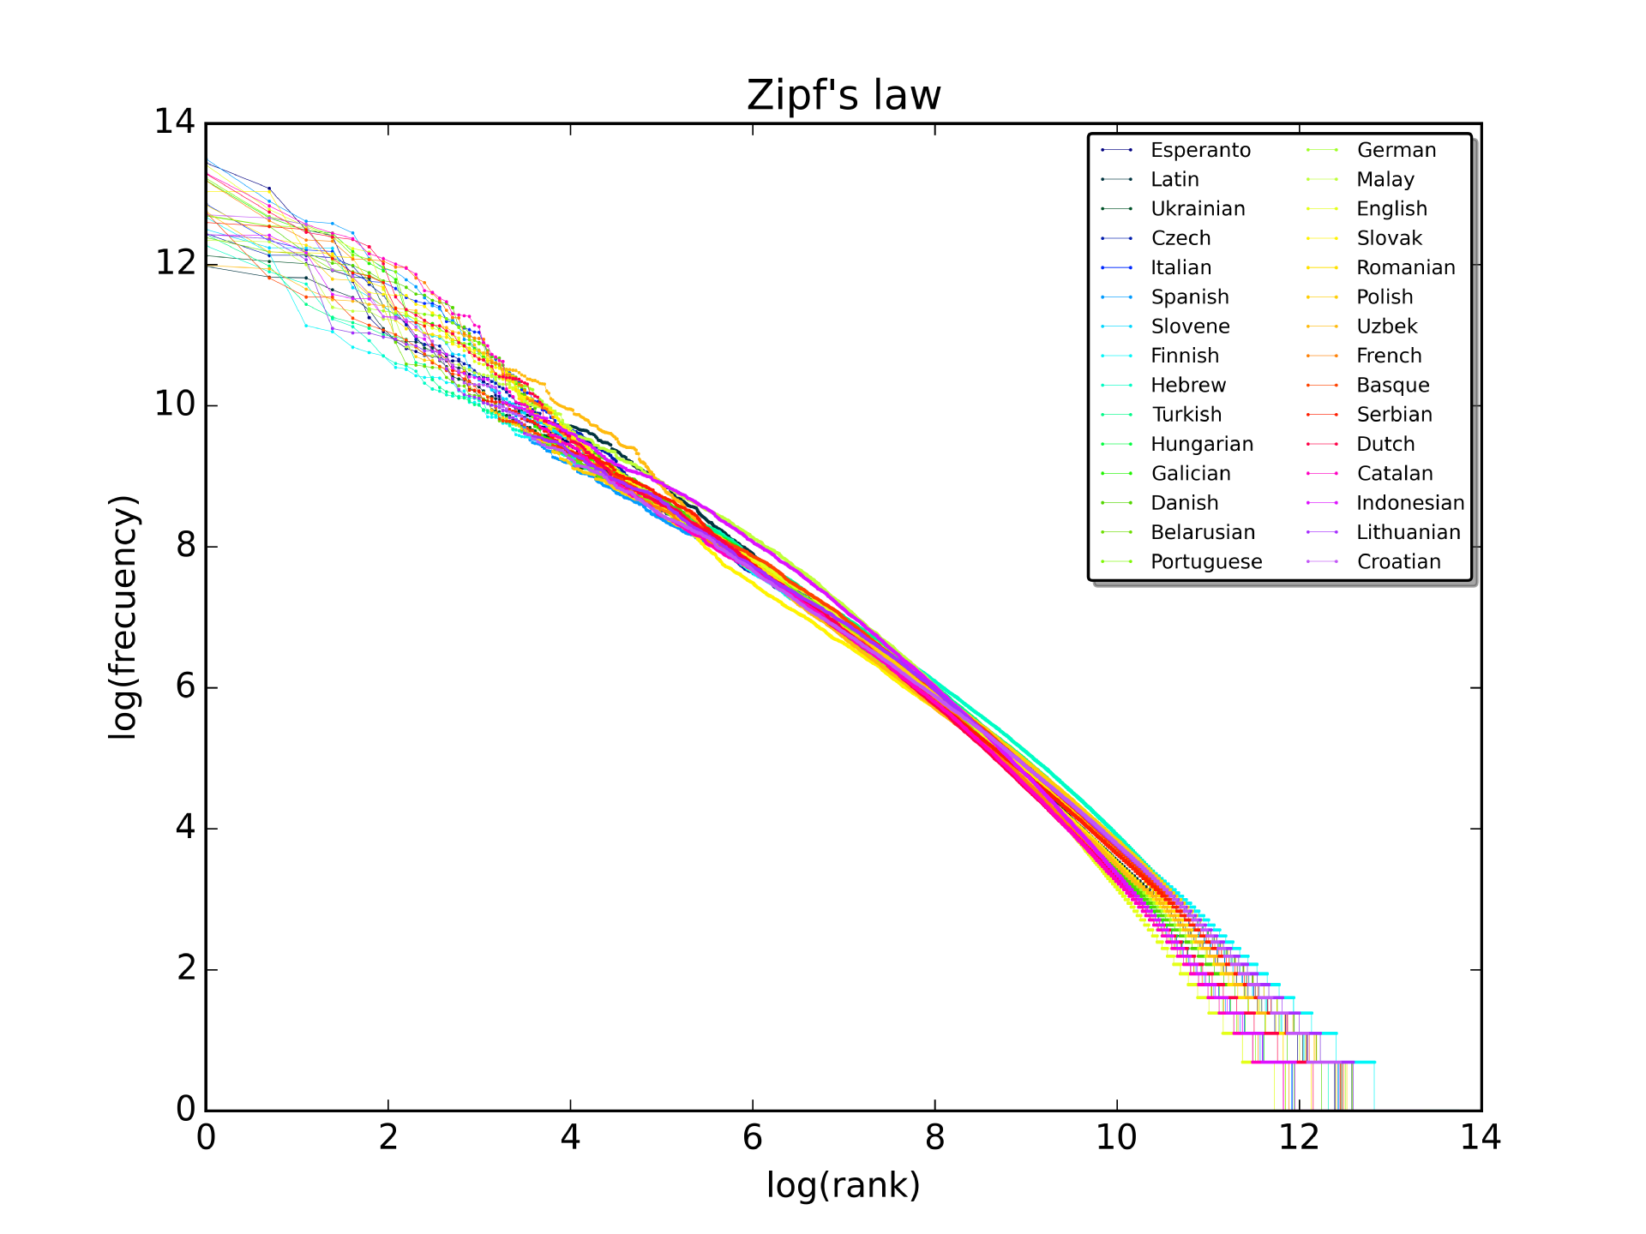
Zipf’s Law Definition
How Important is Regularization in Language?
“given some corpus of natural language utterances, the frequency of any word is inversely proportional to its rank in the frequency table” (Wikipedia)
Notes:
Wikipedia:” Thus the most frequent word will occur approximately twice as often as the second most frequent word, three times as often as the third most frequent word, etc.: the rank-frequency distribution is an inverse relation”
-why is this relevant to regularization? Easy to overfit

Slide 7
Supervised Learning: Data Sets
Naïve Bayes Example Data Sets
Other Data Sets
Training Data
Test Data
Validation or Development Data Set
Tune hyperparameters
Ex) Use to decide when to stop training
Holdout Data Set
Set aside, distinct from cross-validation
Notes:
Development may mean you looked at it, validation is usually specifically to set parameters for machine learning, sometimes they mean the same

Slide 8
N- Fold Cross Validation
Metric of interest
Precision, Recall, F1
Partition data set into N complementary subsets
Use one partition for testing, train on the rest
Pool results over each iteration
Average results across each fold to get an estimate
Why do this?
Gives a better estimate of how your predictive model will perform in practice
Notes:
“Resamping method”

Slide 9
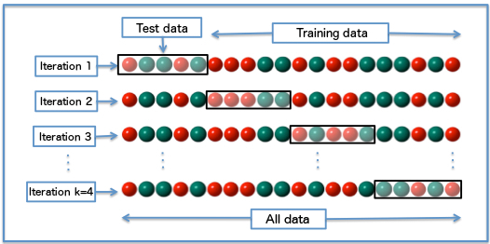
4 –Fold Cross Validation Visualized
https://en.wikipedia.org/wiki/Cross-validation_(statistics)
Notes:
When is cross-validation a better idea?
- When not enough data, leaving a test set that is too small.
Also don’t want vagaries of how you select the set to matter…

Slide 10
Supervised Learning: Features
Feature Definition
Property of phenomenon being observed
A type of input into the machine learning algorithm
Explanatory variable (statistics)
So far, all our features have been words, but how can they be represented?
Sentiment analysis can (and usually does) use other features
How can we encode these features?
Notes:
We are going to focus on

Slide 11
Categorical Data
https://en.wikipedia.org/wiki/Categorical_variable
Qualitative data with no obvious numeric representation
Words
Types of vehicles (sedan, truck, SUV, etc..)
Blood types (A, B, O, AB)
Colors
Diseases
Cylinders in an engine (4 cylinder, 6, cylinder, 8 cylinder)
A numeric representation is often needed for machine learning and statistics
Notes:
2 Types of Categorical data, nominal and ordinal. There are also non-categorical data that we don’t deal with really in NLP, ex) Interval Data (evenly spaced, no zero such as non-Kelvin temperature or IQ tests) and Ratio Data (that has a true zero, like Kelvin Scale)

Slide 12
Ordinal Data Encoding
Ordinal means ordered data
The categories have some natural ordering to them, ex) The number of cylinders in a car
In this situation, data could potentially be encoded in a single dimension using an obvious numeric representation
Text | Numeric Representation
4 cylinder engine | 4
6 cylinder | 6
V8 | 8

Slide 13
Nominal Data: Label Encoding
Simply assign each type of data (for example a word) an integer
Variety of python toolkits will do label encoding for you
from sklearn.preprocessing import LabelEncoder
Problems occur if you draw to make numeric comparison between the different categories
Blood type O isn’t really 4 times “more” than type A
Text Category | Numeric Value
A | 1
B | 2
AB | 3
O | 4

Slide 14
Nominal Data: “One Hot” Encoding
Avoid comparing apples to oranges
Various libraries will do one-hot encoding for you
from sklearn.preprocessing import OneHotEncoder
One hot encoding being supplanted by non-sparse context sensitive word vectors
One-hot good place to start though
Input text
apple, oranges, carrots, apple
Output vectors
[1, 0, 0, 0]
[0, 1, 0, 0]
[0, 0, 1, 0]
[1, 0, 0, 0]
Notes:
There are other encoding methods, could replace the one with a Count for instance

Slide 15
Supervised Learning: Text Classification
Modified Stanford Slides (from slide 20+)
https://web.stanford.edu/~jurafsky/slp3/slides/7_Sent.pdf
Some extra, some missing, some edited…
Sentiment Analysis is one of many simple (yes/no/sorta) document classification tasks, others we have seen before include:
Assessing Grammatical Correctness (CoLA)
Determine correctness of statement given input paragraph (NLI)
Multi-Class Text Classification
Assign labels from a large list to a document, ex) Billing Codes
Assign MESH terms to scientific documents
Notes:
Biomedical not always multinomial and vice versa

Slide 16
Sentiment Analysis Applications
Movies Reviews
Marketing / Sales / Customer Service
Surveys
Chatbots
Call center performance monitoring
Worker happiness monitoring?
Corporate and government surveillance?
Will try to focus on “non-evil” or “less-evil” applications for this course…

Slide 17
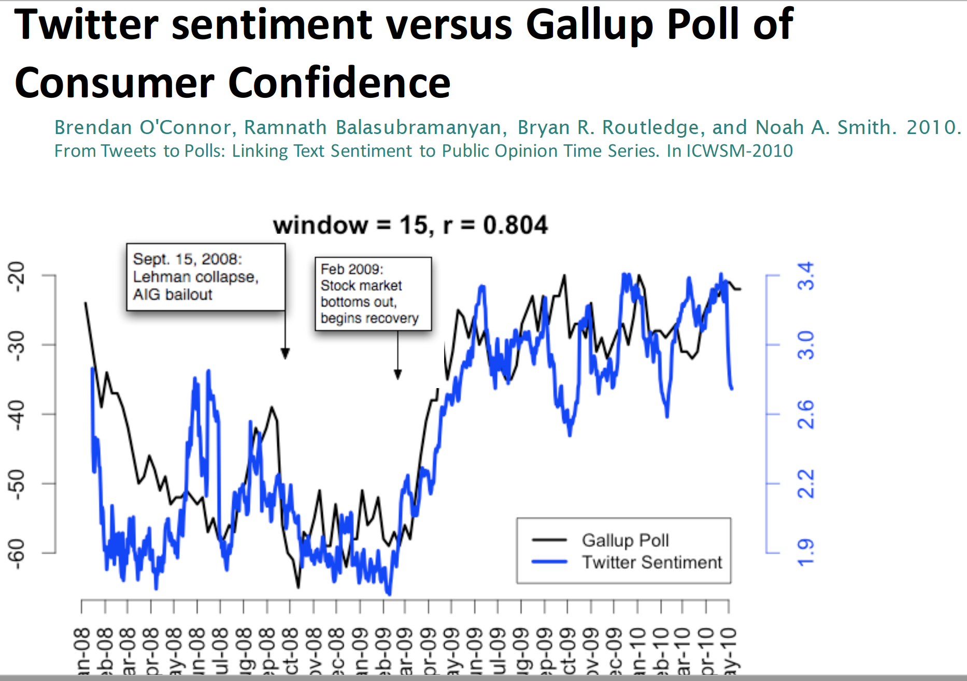
Notes:
Twitter in these notes, many other places to get data from (Reddit easy, Facebook hard)
Realize it is now called “X”, but didn’t want to change my notes in case Elon reverts….

Slide 18
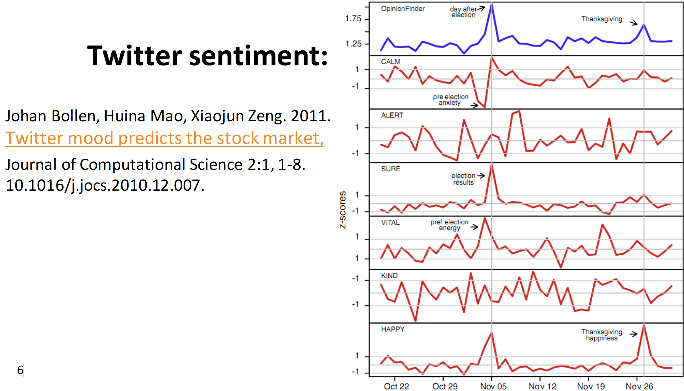
Notes:
6 different dimensions, CALM, ALERT, SURE, etc… instead of usual 2
May not be true after 2020 elections…

Slide 19
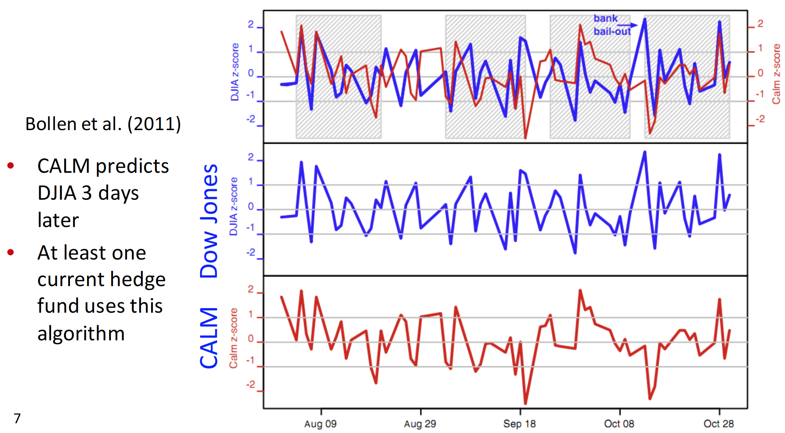
Notes:
CALM opposite is anxiety

Slide 20
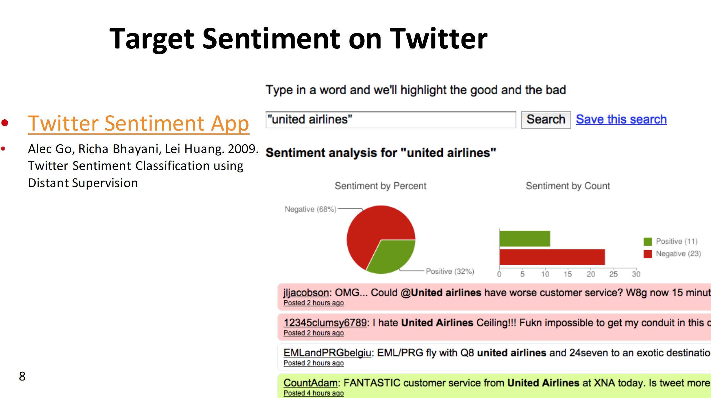
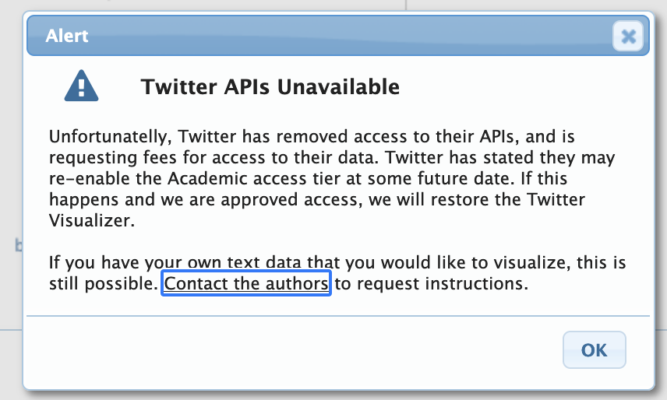
Notes:
Practical application

Slide 21
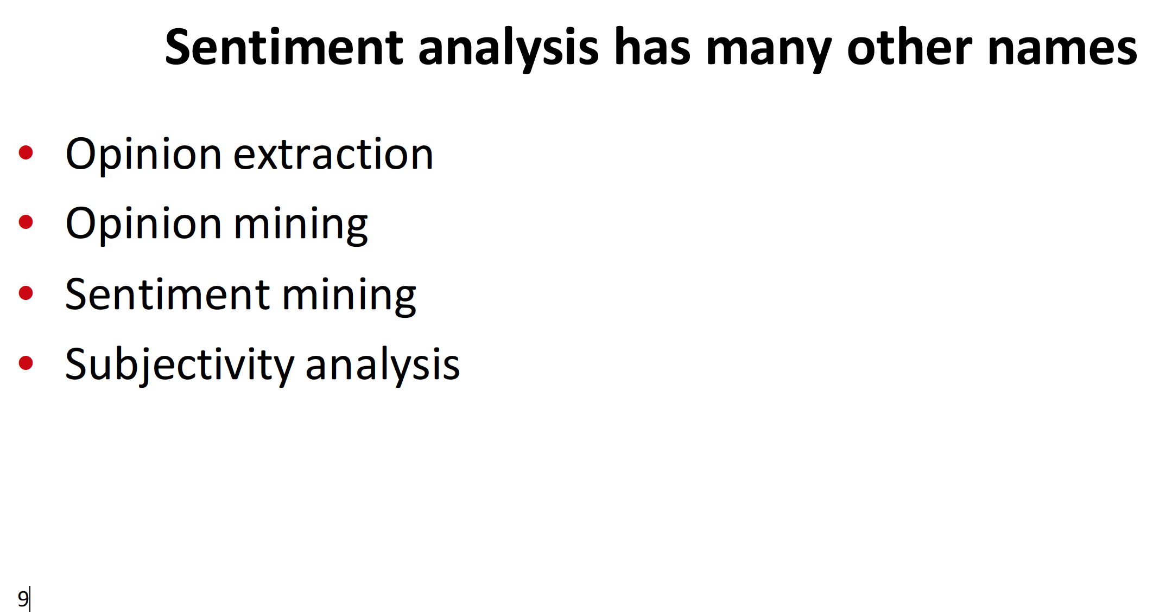

Slide 22
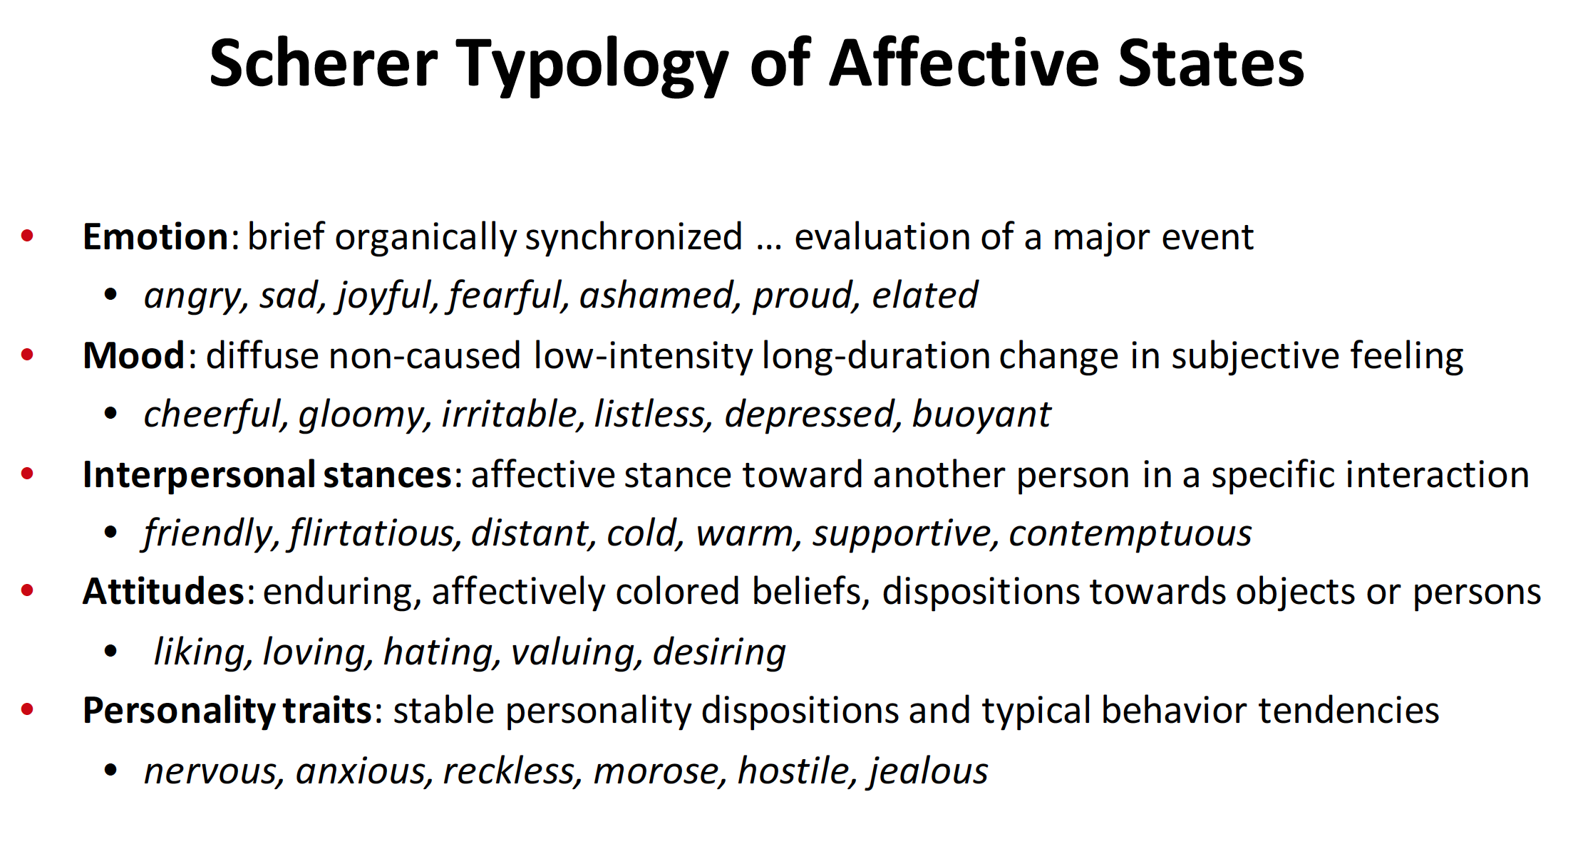
Notes:
When we are talking about sentiment, what are we really talking about?
*Attitudes* are the focus on sentiment analysis – why?

Slide 23
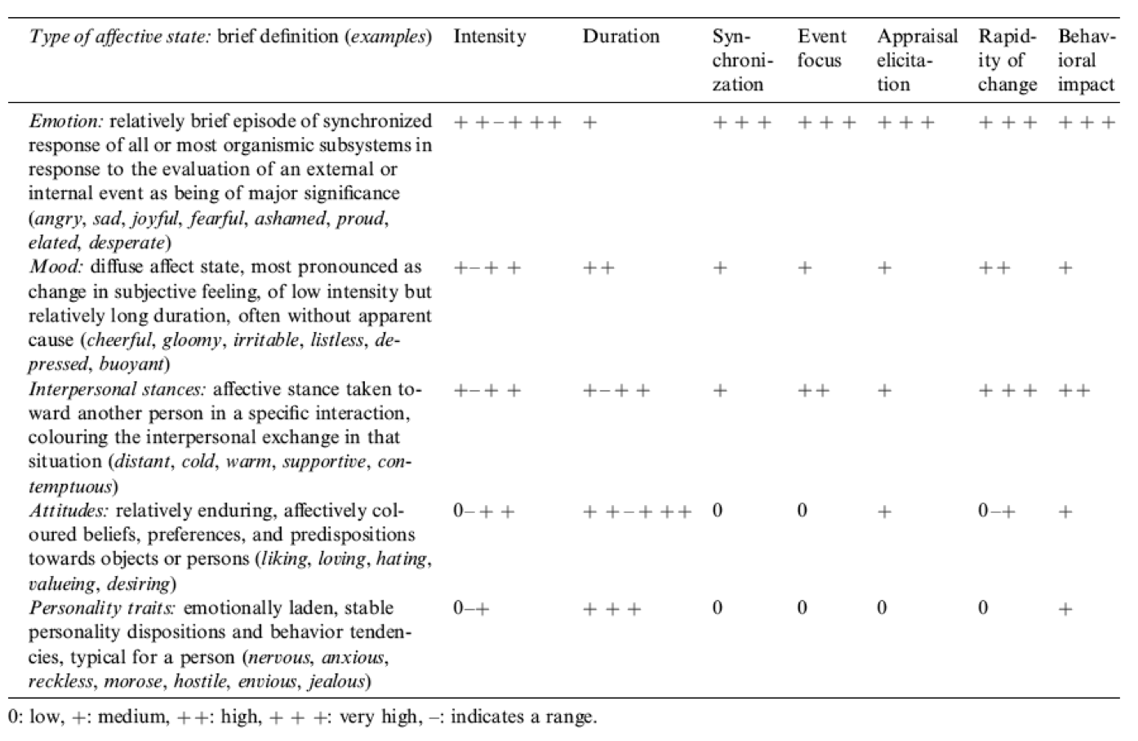
Notes:
Biggest marketing impact
Long duration, can be fairly quickly changed (but not too easily)

Slide 24
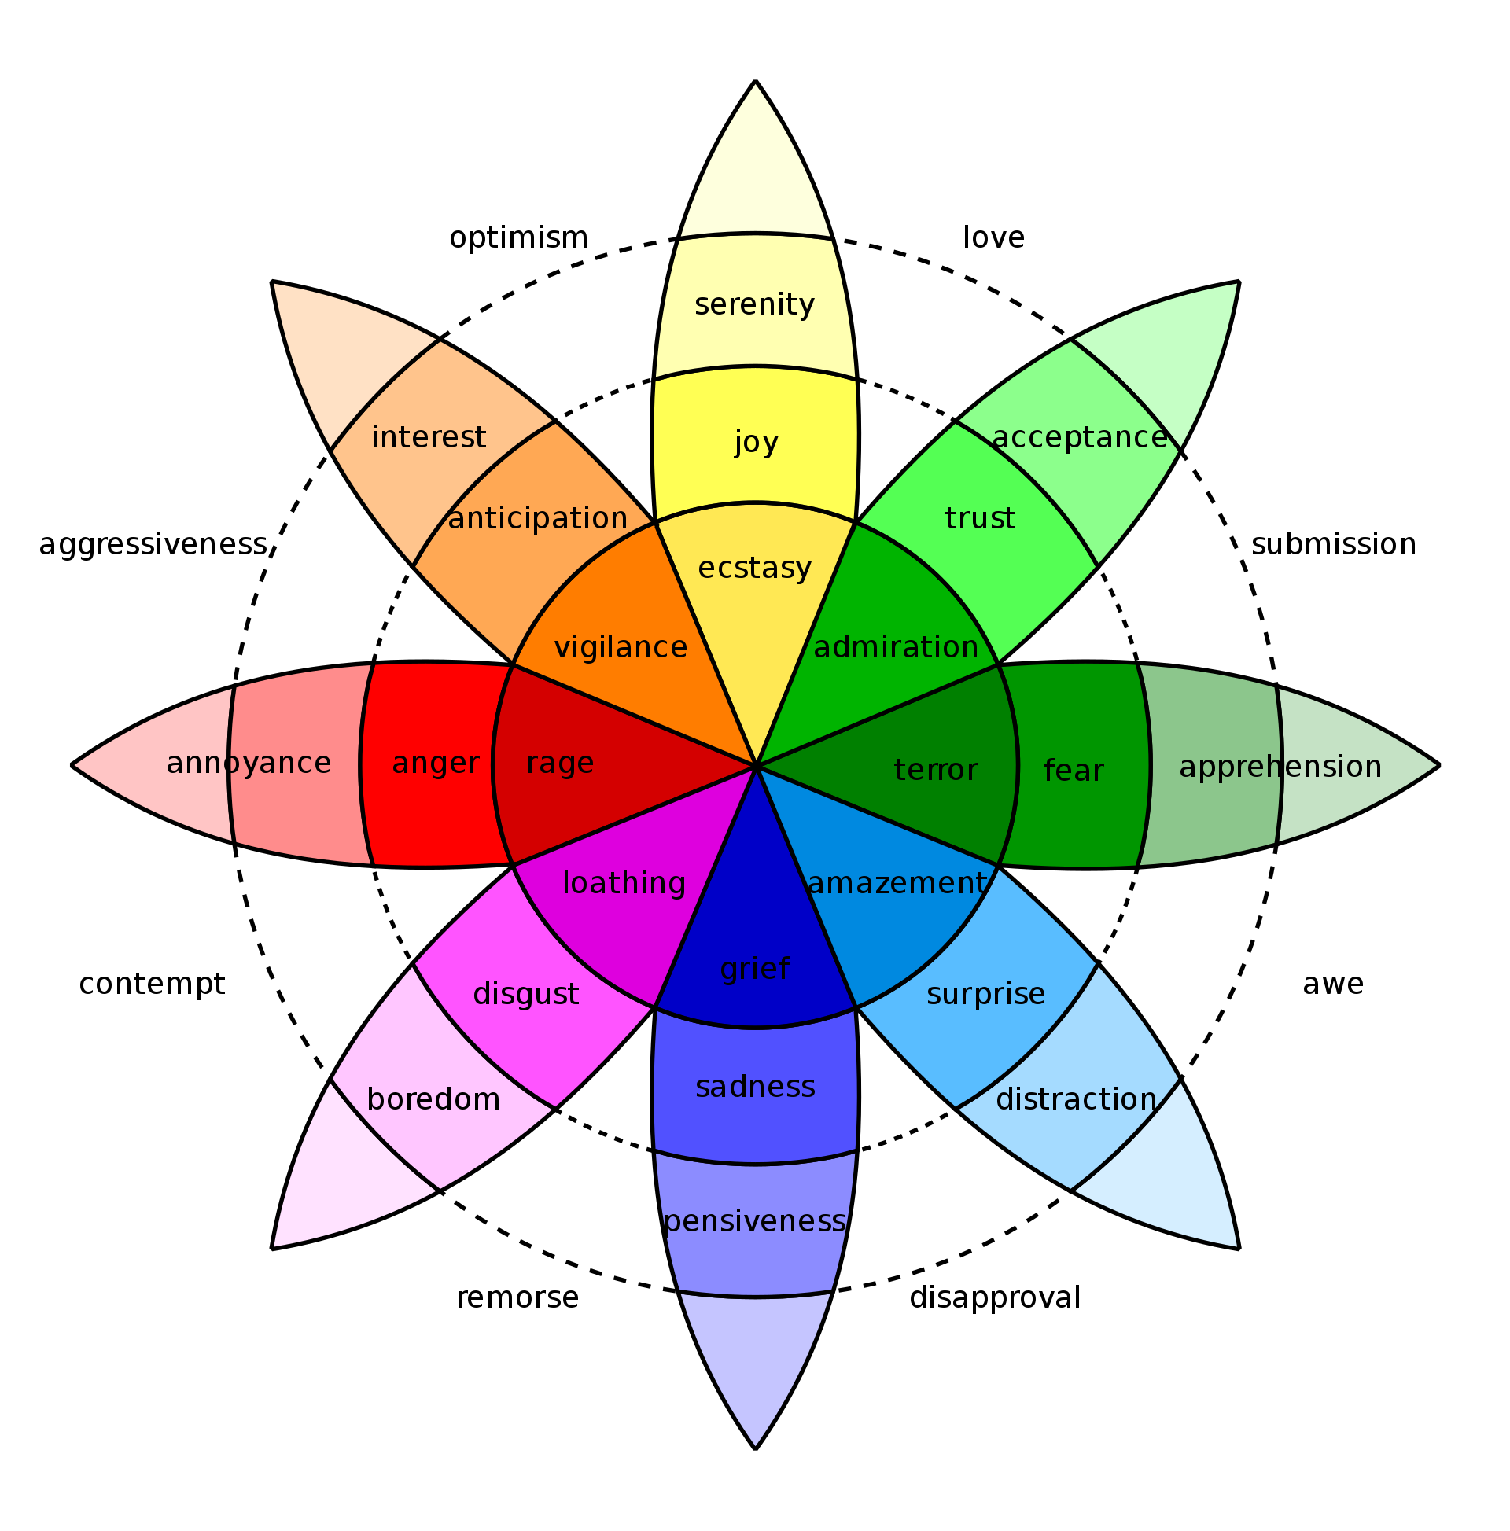
Robert Plutchik's Wheel of Emotions.
Notes:
Sentiment is more complicated than just up and down…
Intensity is also a factor, models (supposedly) more sophisticated now

Slide 25
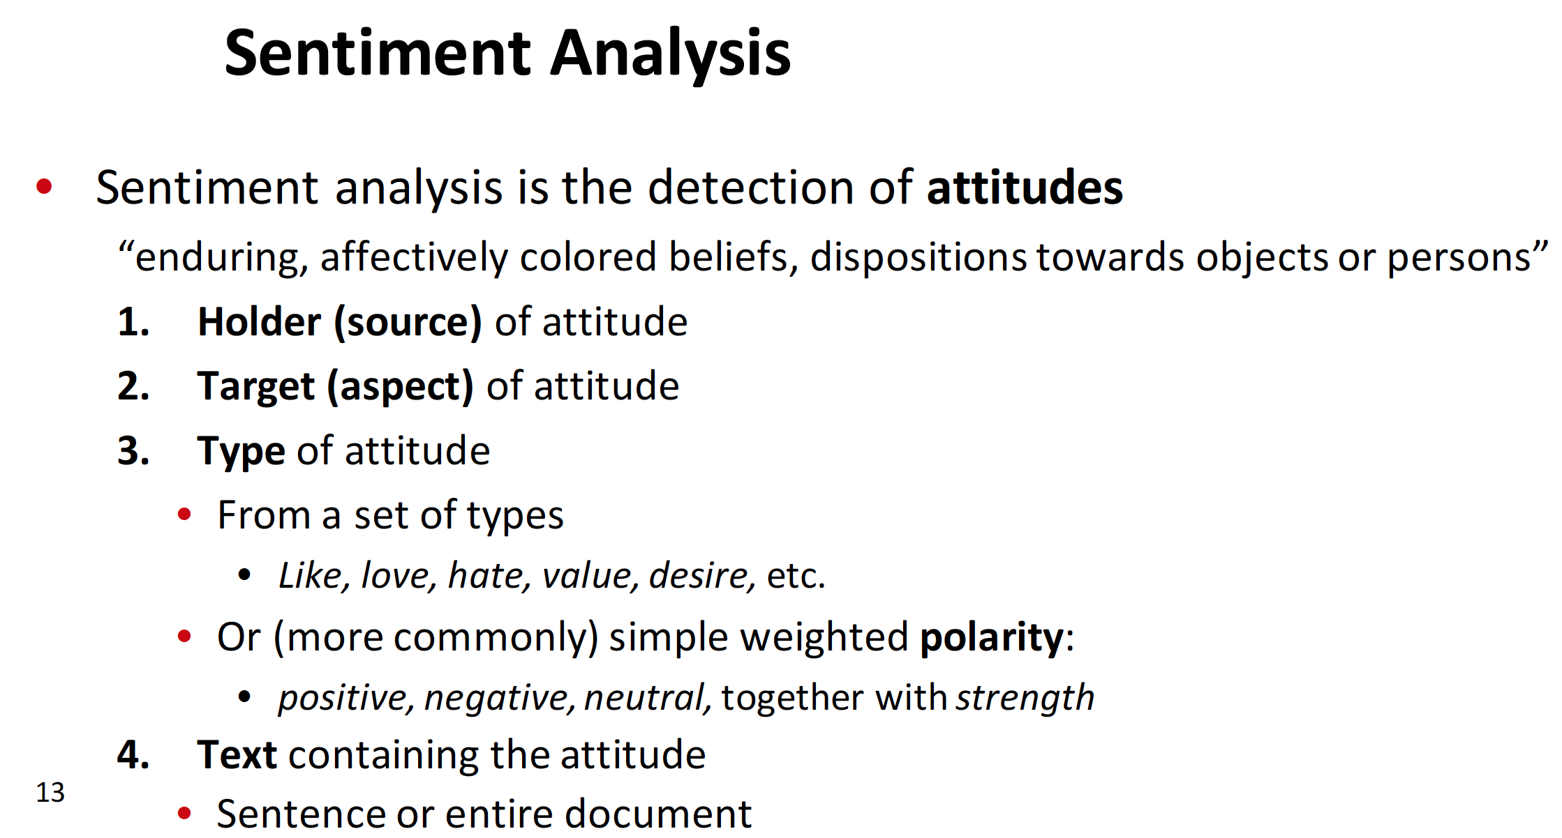
Notes:
Holder is the person or target market
Target is the product/service in a commercial sense
Type is attitude
Text contains the attitude

Slide 26
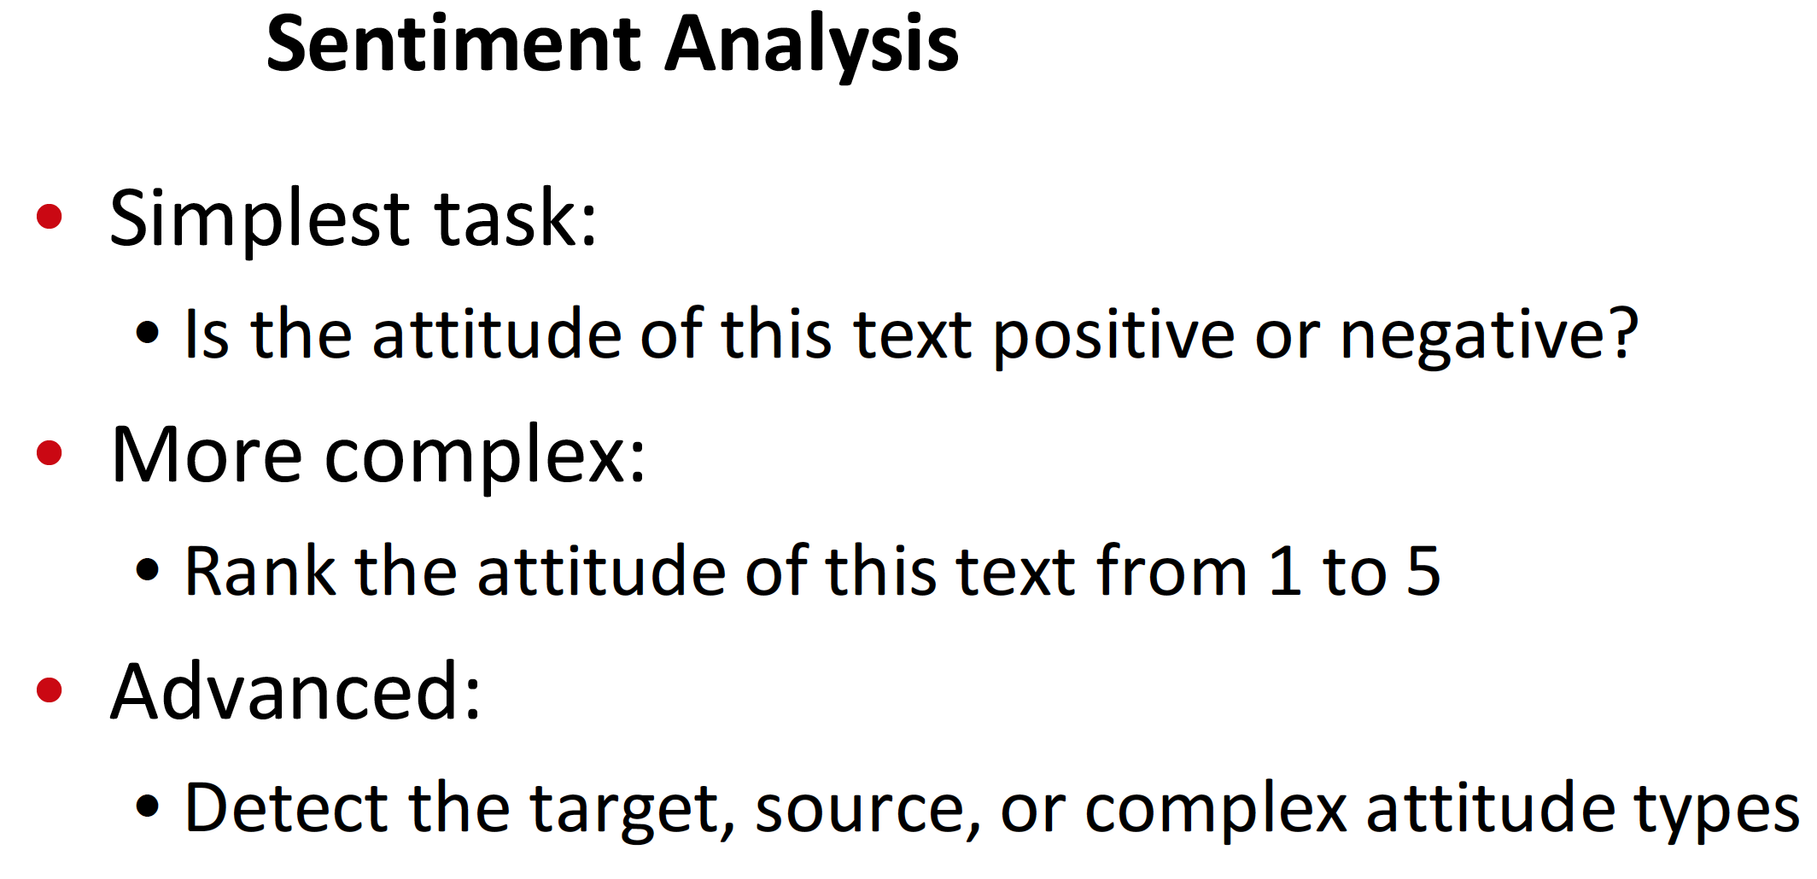
Notes:
Advanced is harder, maybe you want to identify a marketing (or astroturfing) campaign

Slide 27
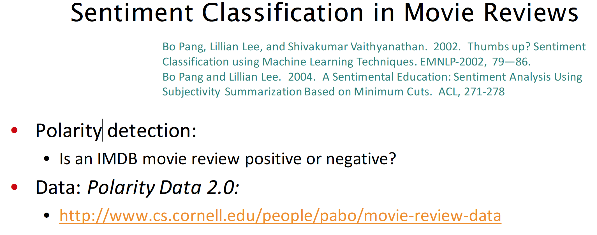
Notes:
Unencrypted but link still exists!
Popular project for class often…

Slide 28
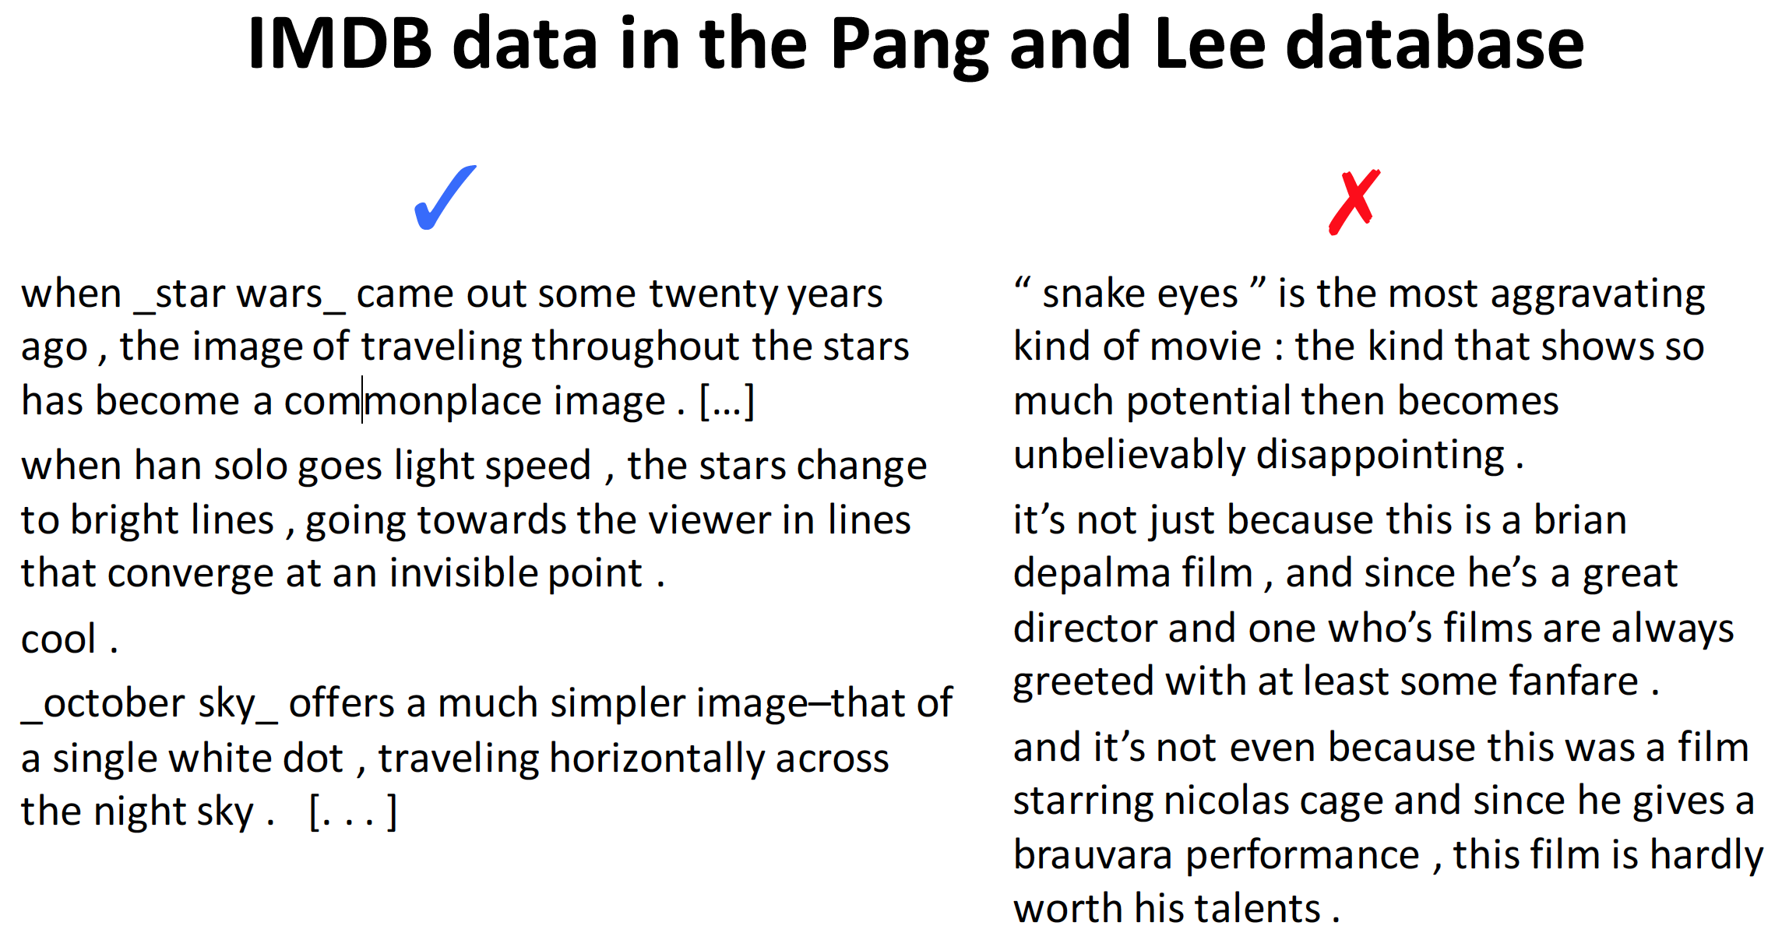

Slide 29
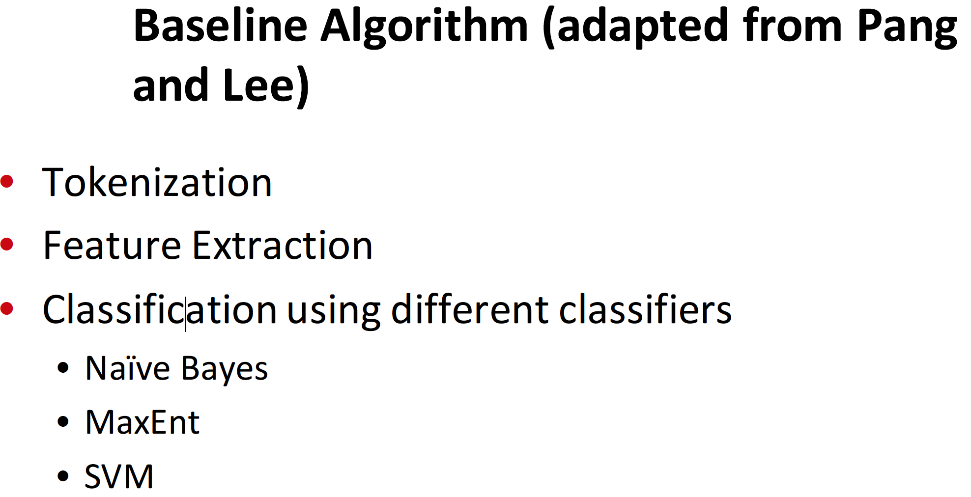
Notes:
MaxEnt is Naives Bayes with weights, try to optimize training data, don’t just use counts
The Maximum Entropy (MaxEnt) classifier is closely related to a Naive Bayes classifier, except that, rather than allowing each feature to have its say independently, the model uses search-based optimization to find weights for the features that maximize the likelihood of the training data." (source: http://sentiment.christopherpotts.net/classifiers.html#nb)

Slide 30
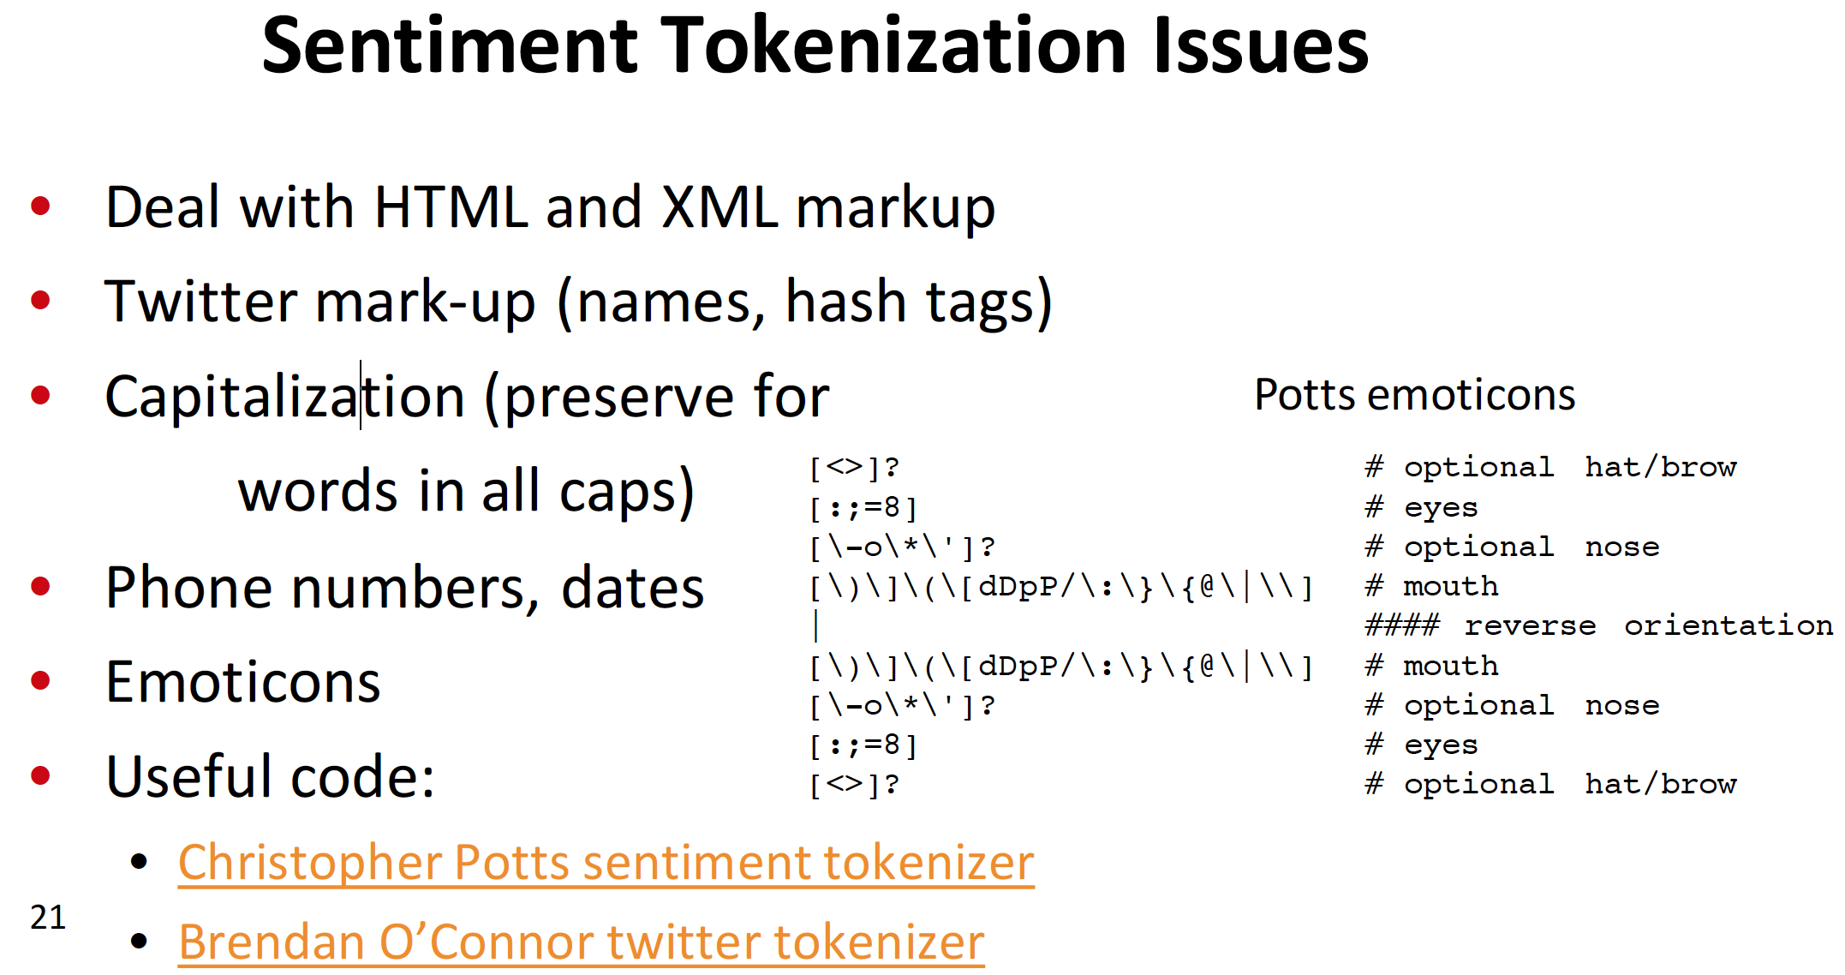
Notes:
Beautiful Soup in python can help

Slide 31
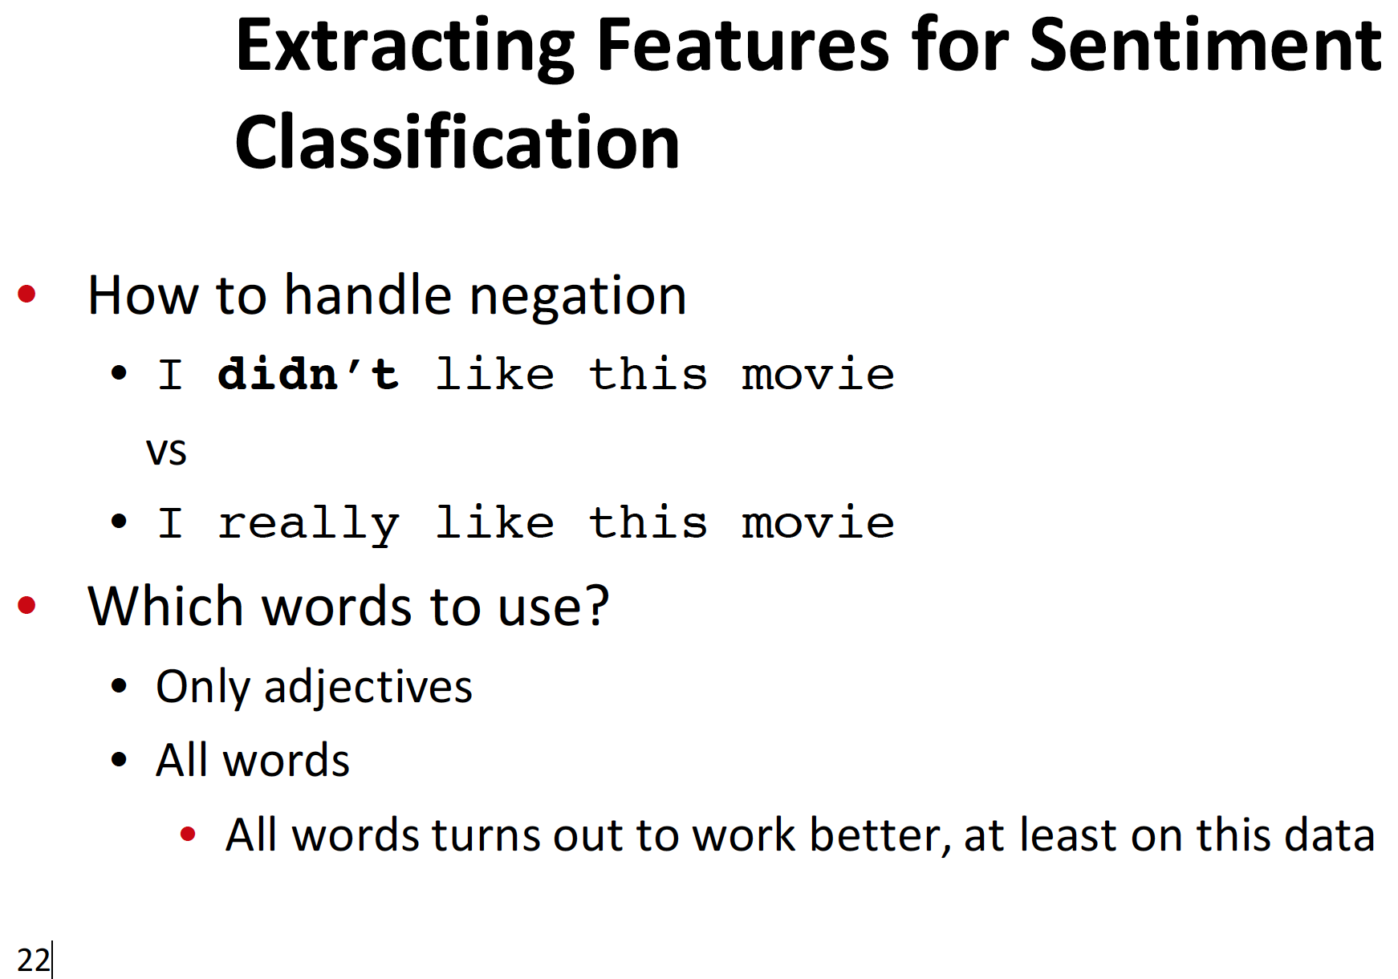
Feature Engineering
Notes:
Do Deep Learning methods in NLP have feature engineering?
-BPE or equivalent could be viewed as feature engineering, but features are also learned rather than decided up front

Slide 32
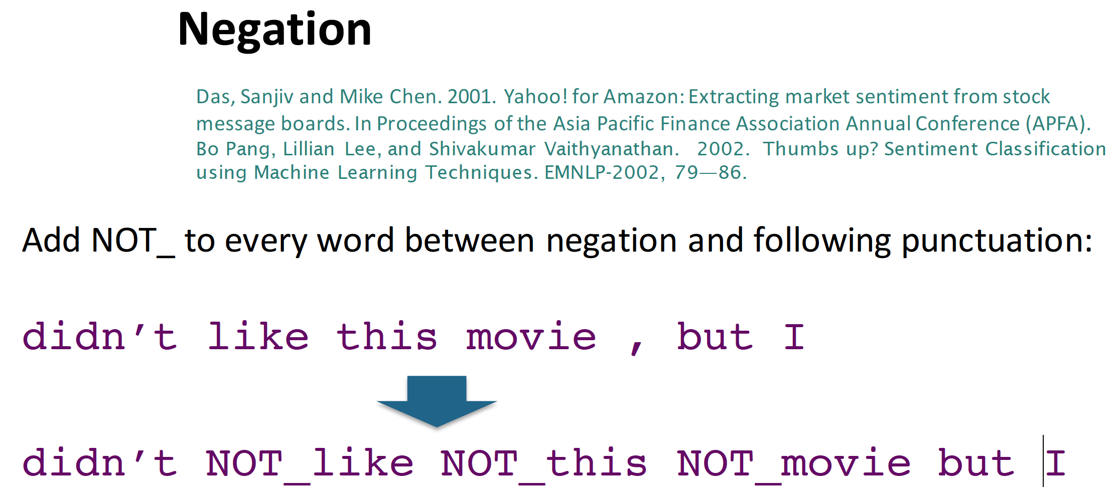
Notes:
Very primitive, simple algorithm
Many negation still works based on rules though

Slide 33

Notes:
Clinical applications of negation
Performance is very good, >98 or 99% in simple corpora

Slide 34
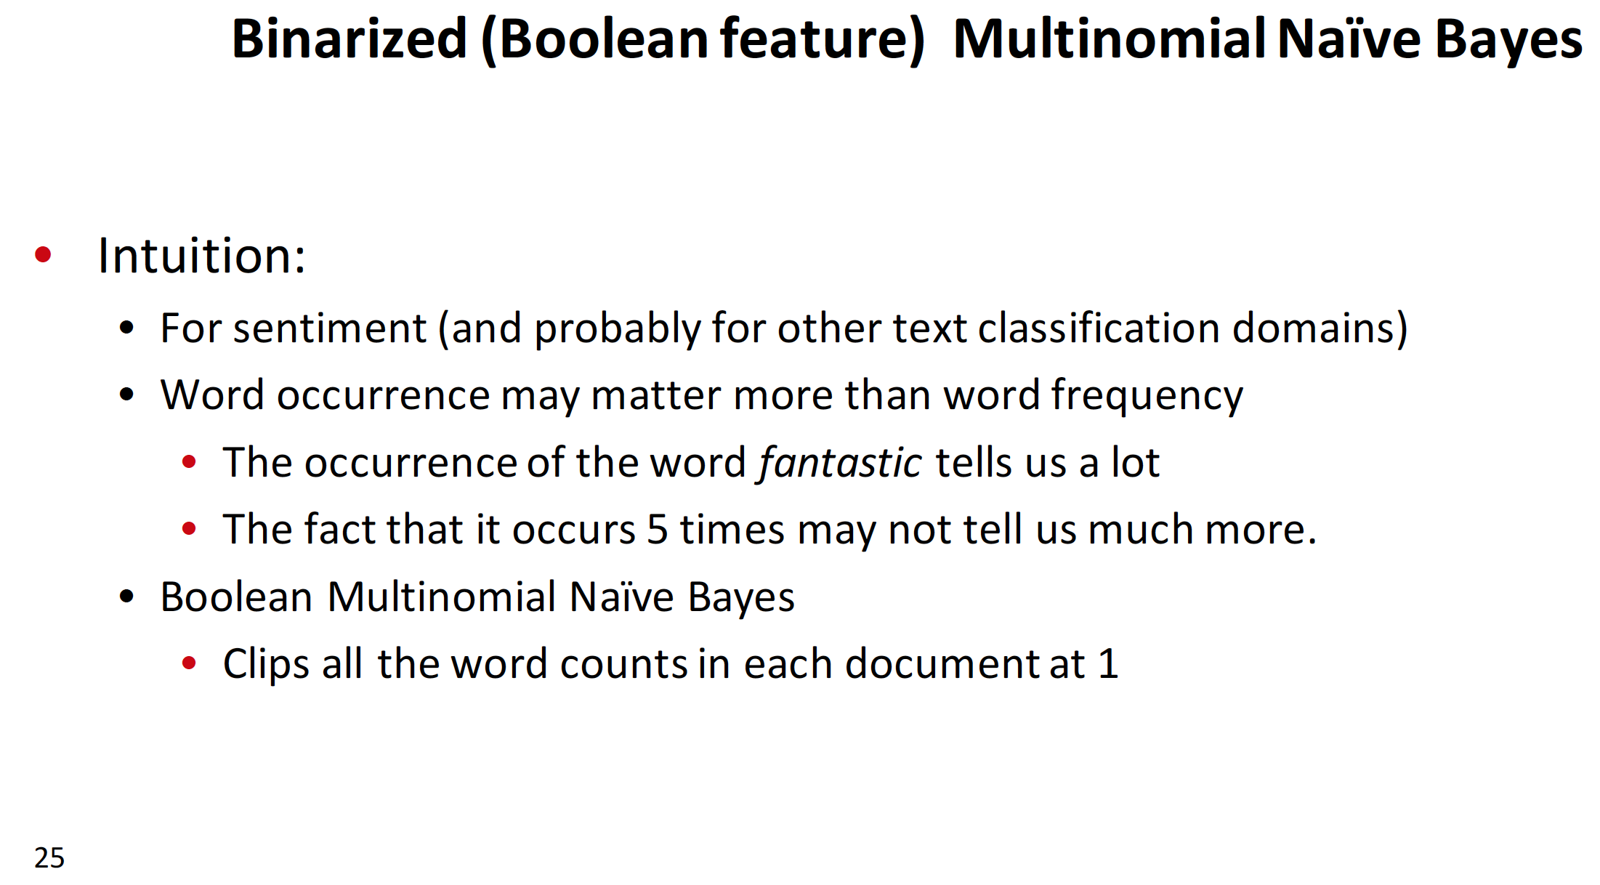

Slide 35
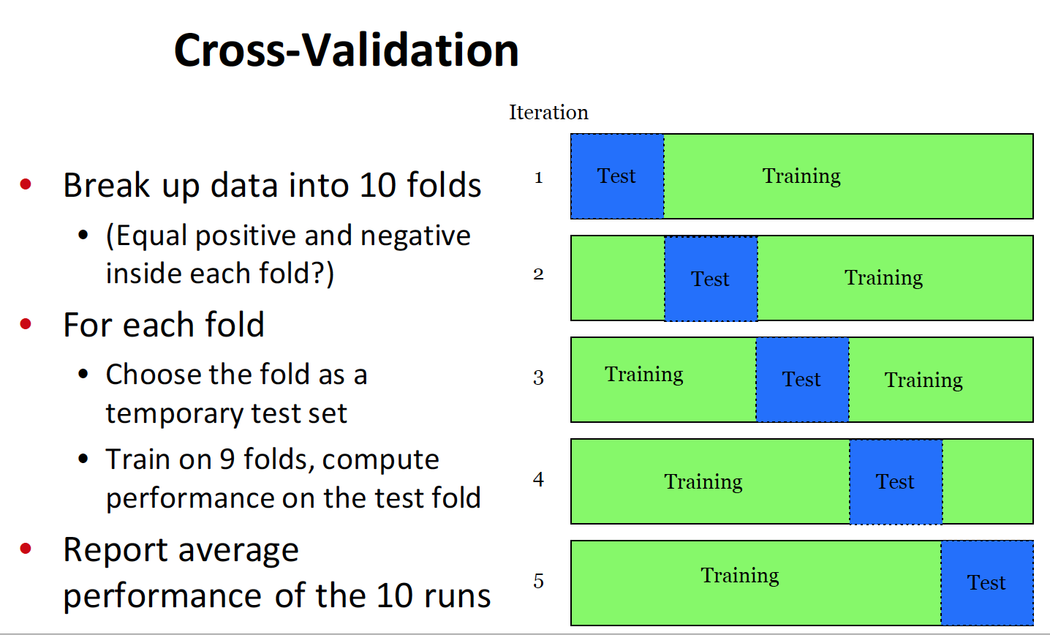
Notes:
Pang and Lee experiment,
-Should we have equal positive and negative in each fold?
-Depends, generally want training to look like test (some maybe not 50-50) BUT want enough to learn smaller class (don’t want to focus on making 1 type of prediction)
-notice this is simple, no validation set here, looks like Naïve Bayes training but many other methods may have validation data set

Slide 36
Results (Pang and Lee)
Binary seems to work better than full word counts
Could also use log(freq(w))
MaxEnt and SVM do better than Naïve Bayes in general
Notes:
No feature independence in MaxEnt
SVM discriminative, gets maximally separating plane

Slide 37
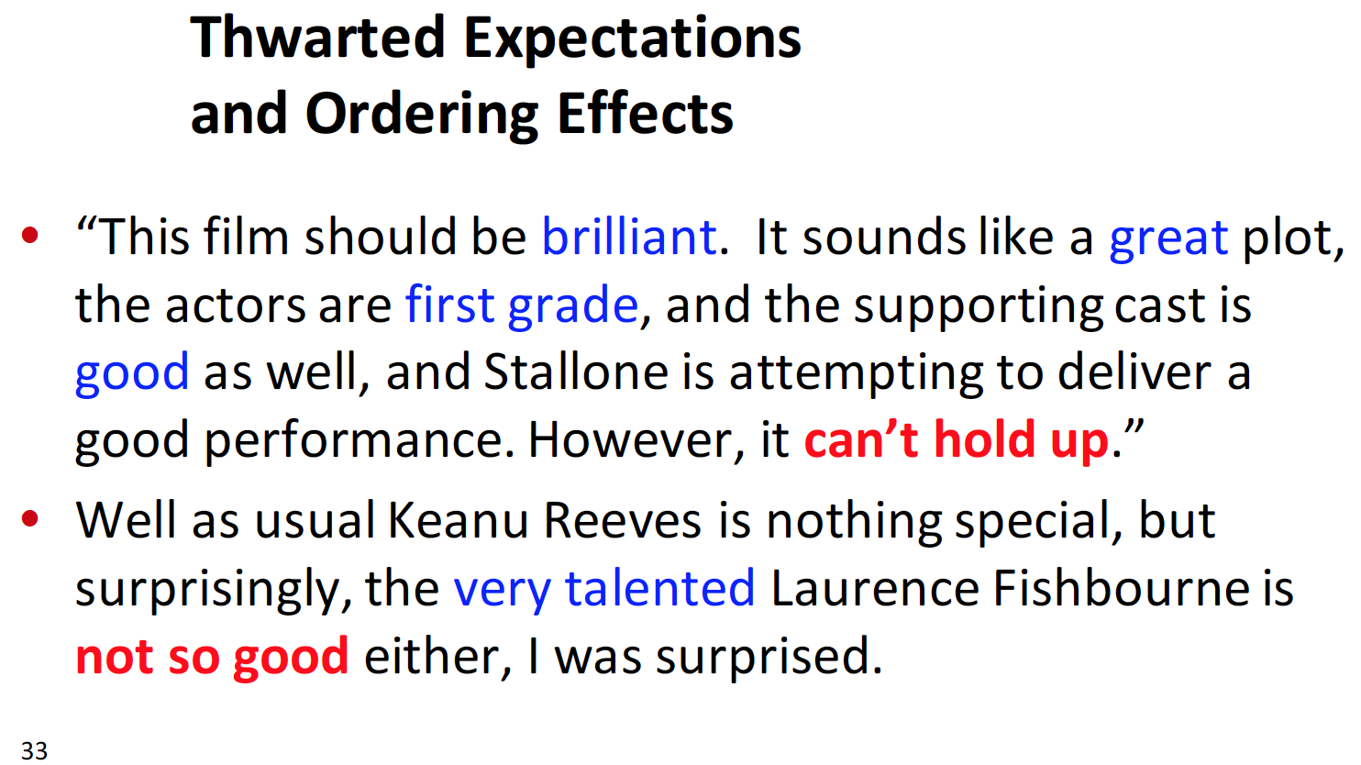

Slide 38
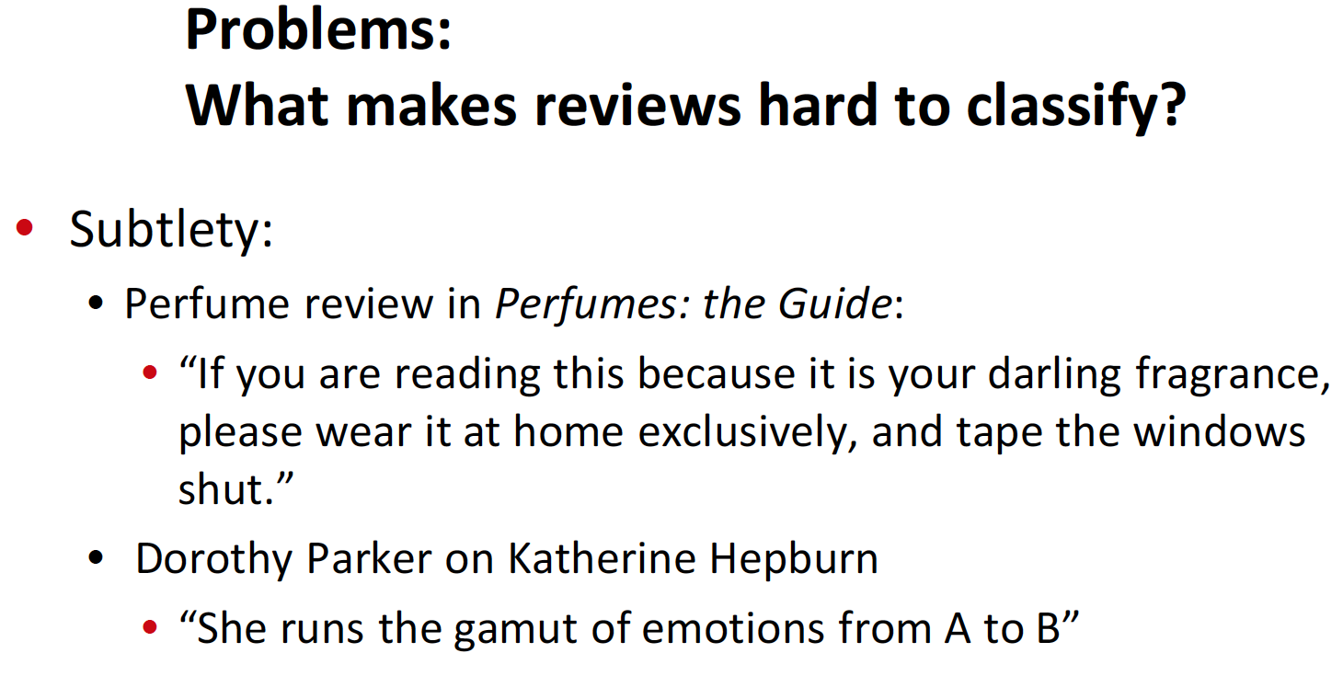

Slide 39
Text Classification and Naïve Bayes
Text Classification: Practical Issues

Slide 40
The Real World
Sec. 15.3.1
Gee, I’m building a text classifier for real, now!
What should I do?

Slide 41
No training data? Manually written rules (or zero-shot LLM!)
Sec. 15.3.1
If (wheat or grain) and not (whole or bread) then
Categorize as grain
Need careful crafting
Human tuning on development data
Time-consuming: 2 days per class

Slide 42
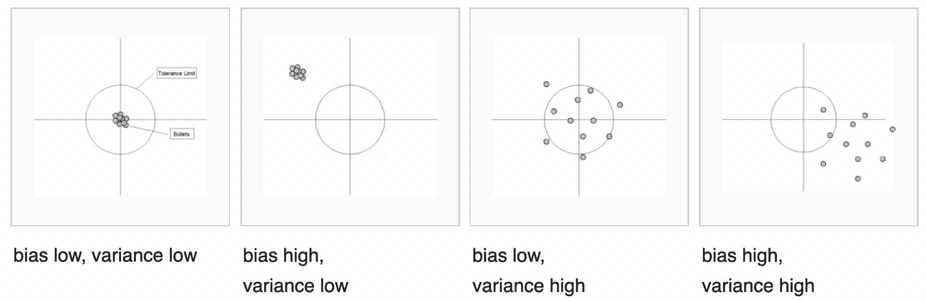
Very little data? (or few-shot LLM!)
Sec. 15.3.1
Use Naïve Bayes
Naïve Bayes is a “high-bias” algorithm (Ng and Jordan 2002 NIPS)
Get more labeled data
Find clever ways to get humans to label data for you
Try semi-supervised training methods:
Bootstrapping, EM over unlabeled documents, …
Notes:
Naïve Bayes underfits because it is so simple
Another option is transfer learning…

Slide 43

Little data post 2019?
Transfer learning
https://huggingface.co/docs/transformers/tasks/sequence_classification

Slide 44
A reasonable amount of data?
Sec. 15.3.1
Perfect for all the clever classifiers
SVM
Regularized Logistic Regression
SFT on a neural network
You can even use user-interpretable decision trees
Users like to hack
Management likes quick fixes

Slide 45
A huge amount of data?
Sec. 15.3.1
Can achieve high accuracy!
At a cost:
SVMs (train time) or kNN (test time) can be too slow
Regularized logistic regression can be somewhat better
So Naïve Bayes can come back into its own again!
Notes:
Most neural methods will also work

Slide 46
Real-world systems generally combine:
Automatic classification
Manual review of uncertain/difficult/"new” cases

Slide 47
Accuracy as a function of data size
Sec. 15.3.1
With enough data
Classifier may not matter
Brill and Banko on spelling correction
Notes:
Seen in larger

Slide 48
Document Classification in Biomedical Space
Multi-label documentation classification (tagging) is more prevalent
Less attention in this space for single label document classification
Document meta-data is often easier to capture and use
Format is often highly structured making the problem easier
Often held in document repositories that may have already done classification or indexing
Document classification often just feature extraction in clinical space
Few mentions of document classification in the bioinformatics space with some exceptions

Slide 49
Systematic Review
Wikipedia Definition
“Systematic reviews are a type of literature review that uses systematic methods to collect secondary data, critically appraise research studies, and synthesize studies. Systematic reviews formulate research questions that are broad or narrow in scope, and identify and synthesize studies that directly relate to the systematic review question.”
Text Classification Problem
Is this document a document I need to review for my research question?
Binary or scoring threshold
Buchlak, Quinlan D., Joe Clair, Nazanin Esmaili, Arshad Barmare, and Siva Chandrasekaran. "Clinical outcomes associated with robotic and computer-navigated total knee arthroplasty: a machine learning-augmented systematic review." European Journal of Orthopaedic Surgery & Traumatology (2021): 1-17.
Begert, David, Justin Granek, Brian Irwin, Chris Brogly, and A. I. Xtract. "Using automation for repetitive work involved in a systematic review." CCDR 46, no. 6 (2020): 174-179.
https://www.canada.ca/en/public-health/services/reports-publications/canada-communicable-disease-report-ccdr/monthly-issue/2020-46/issue-6-june-4-2020/using-automation-repetitive-work-involved-systematic-review.html
https://link.springer.com/article/10.1007/s00590-021-03059-0

Slide 50
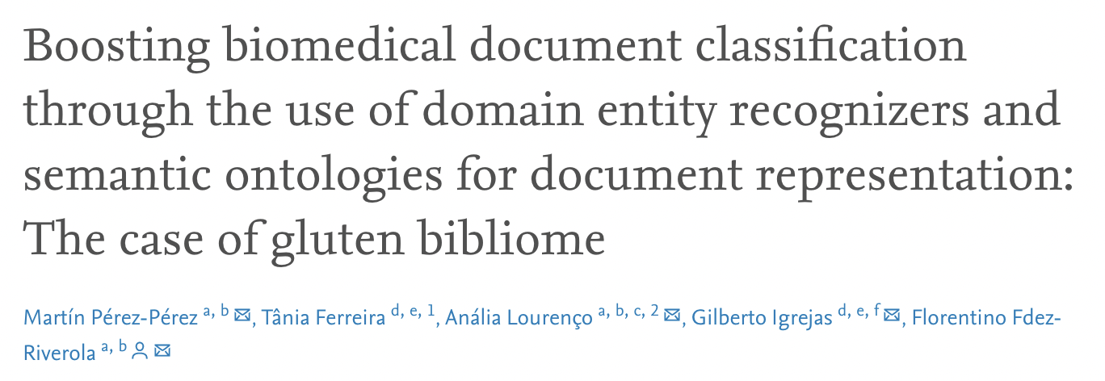
Goal is literature classification
4,115 gluten-related documents extracted from PubMed and contrasted against the word embedding alternative
Effective because it uses NER…
Notes:
Word embeddings can be used for search, we will introduce this as part of the next lecture
NER is going to do better though, gets directly to the point (gluten in this case)

